Slide 1
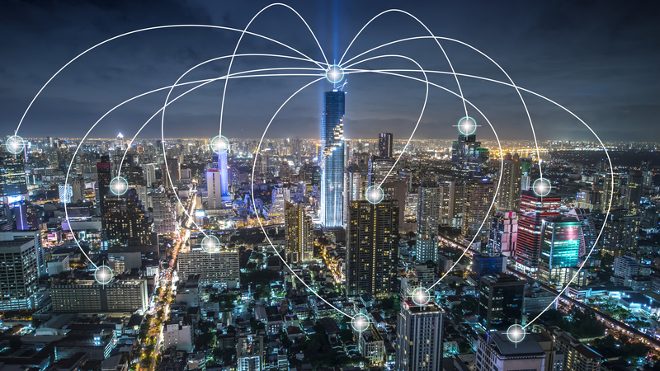
Automatic PnP with external data
Branch routers are pre-installed
Routers in Cisco DNA Center
Campus Switching Dynamic PnP
Router Connected port logic
Variables stored in external DB

Slide 2
Automated Plug-and-Play
4 switches pending in PnP
Identify a Cat2k & Cat9k on a Branch ISR4k
Script polls regularly PnP pending devices
Takes the first in the list
Does a lookup in a DB (like mySQL) for a match
Gets config template & device details from DB
Inject Config in PnP
Associate SN (captured in pending state) with config

Slide 3
The Cisco DNA-Center claiming process
Get List of Unclaimed (pending) devices
Select the first device in the list of unclaimed devices
Lookup parameters & site information from your database (json, SQL,...)
Get the siteID based of the site name found in the database
Get the Template ID for the device based on template name in the database
Build your JSON post data incl template parameters
Post a claim to site
1
2
3
4
5
6
7

Slide 4
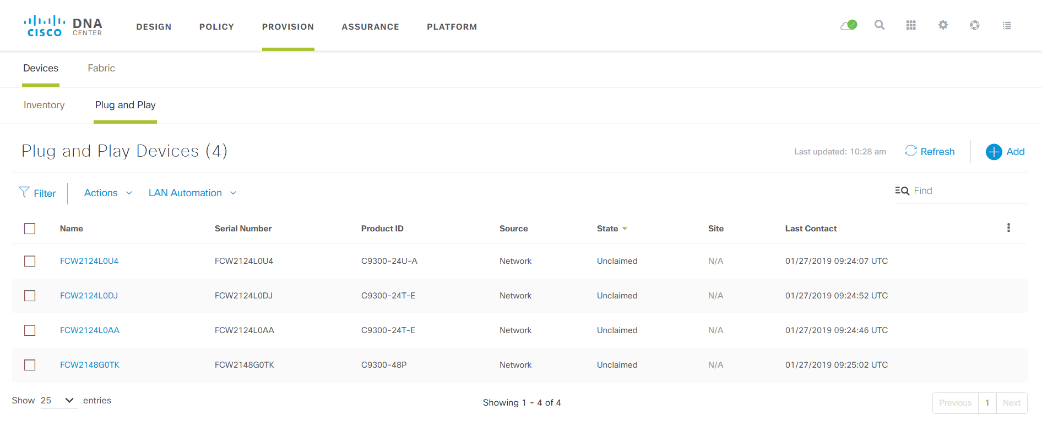
Automated Plug-and-Play

Slide 5
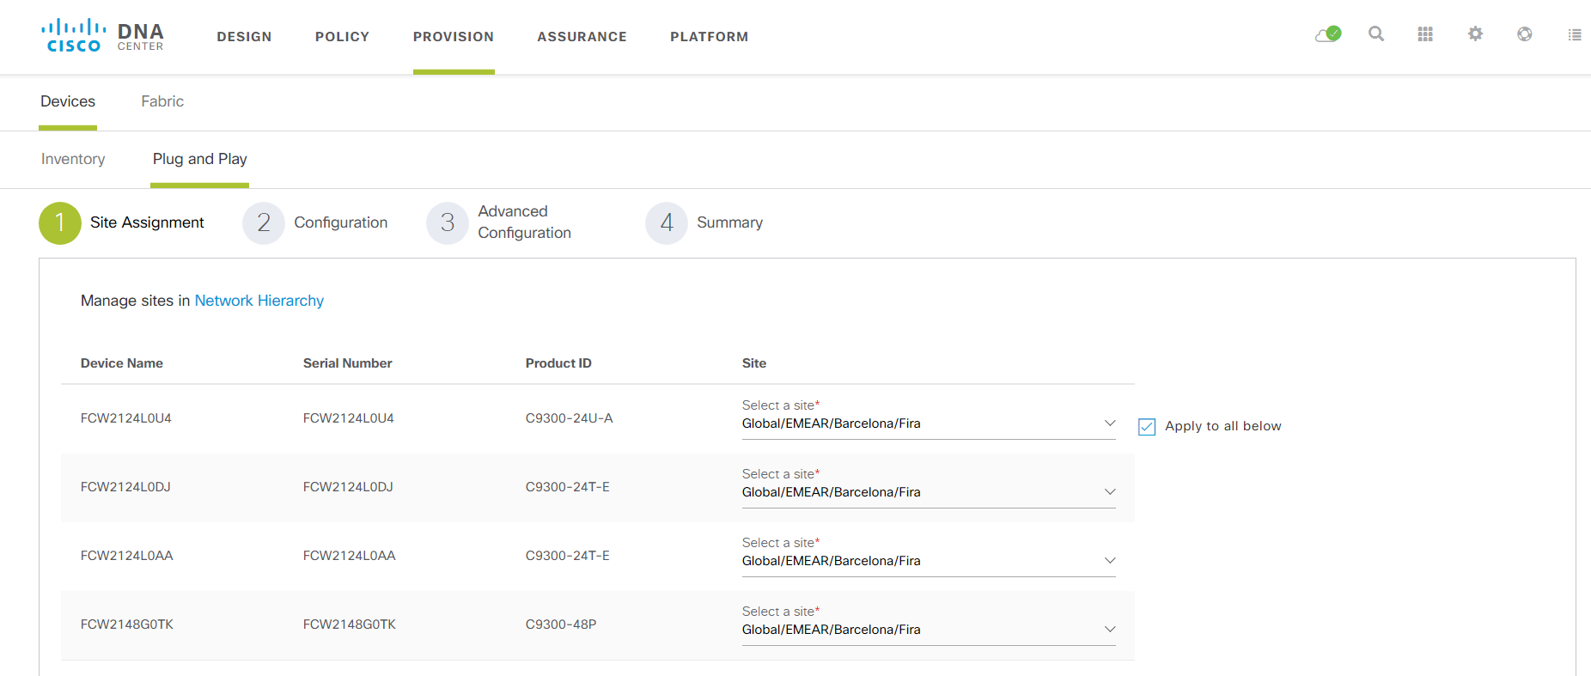
Automated Plug-and-Play

Slide 6
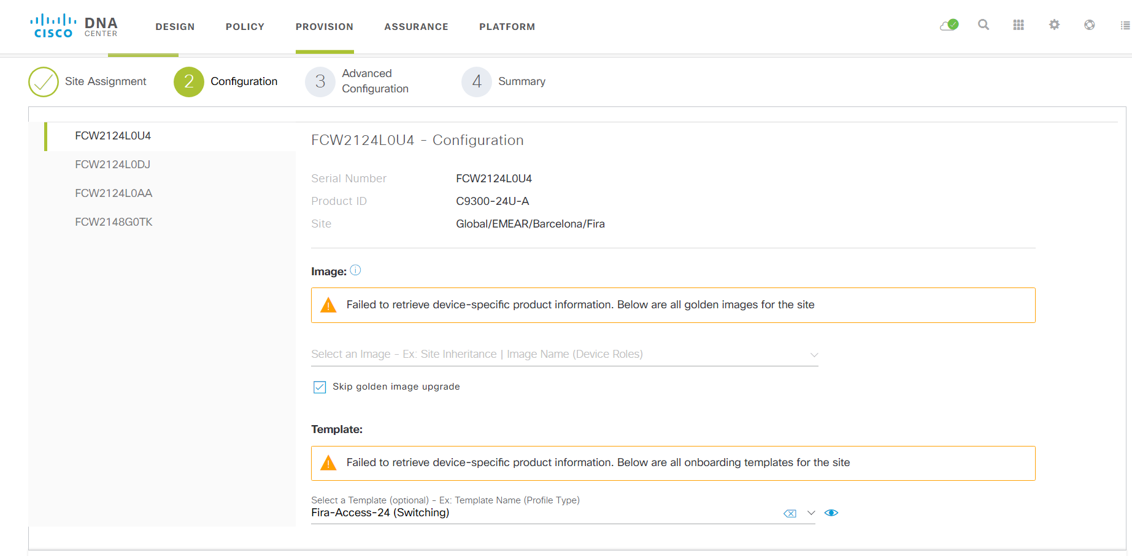
Automated Plug-and-Play

Slide 7
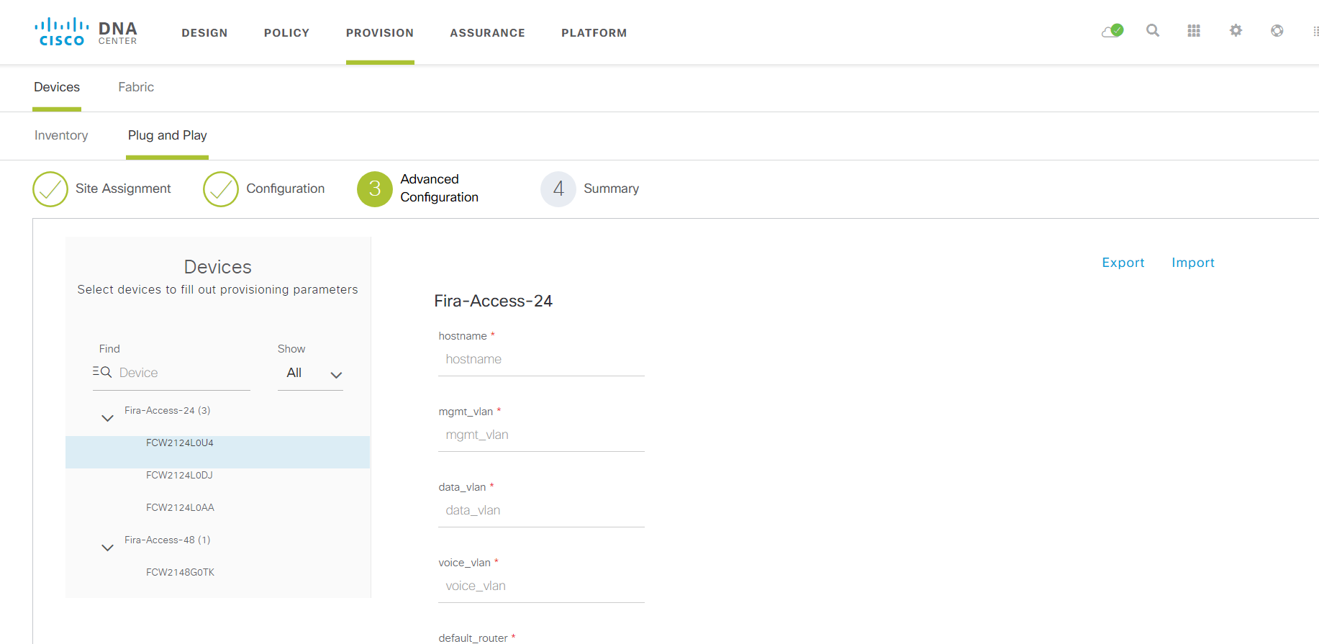
Automated Plug-and-Play

Slide 8
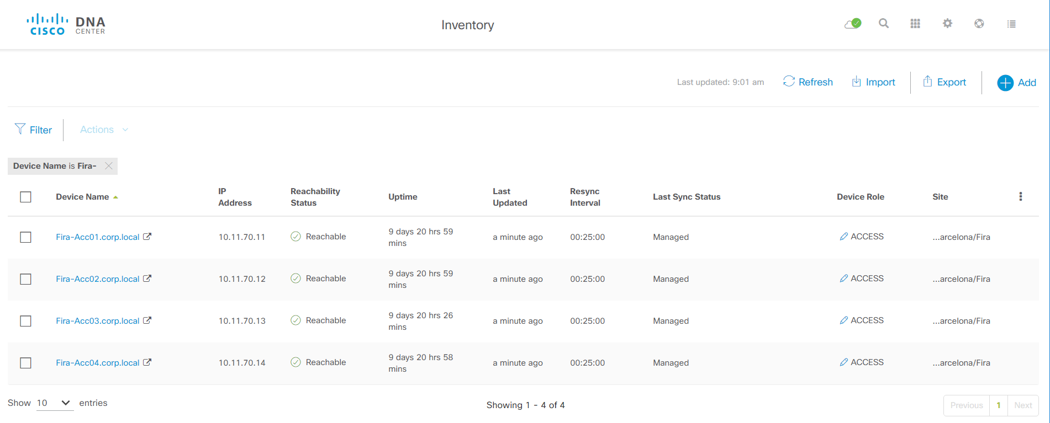
Automated Plug-and-Play

Slide 9
Case #4 Something is missing
Logical order based on interface
Site depending on neighbor router
Dynamic hostnames
Automatic template selection
So... We need logic!

Slide 10
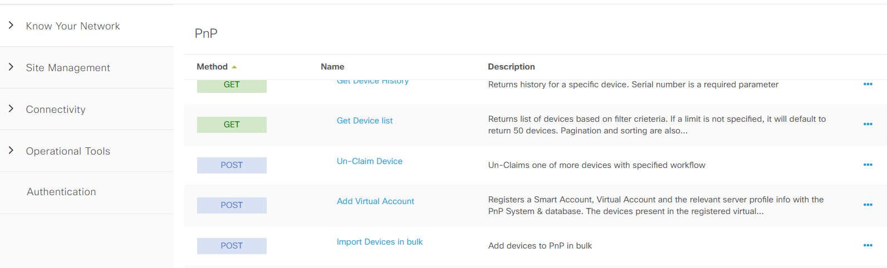
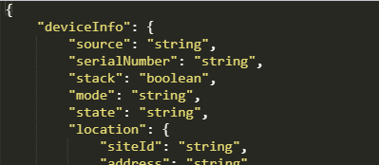
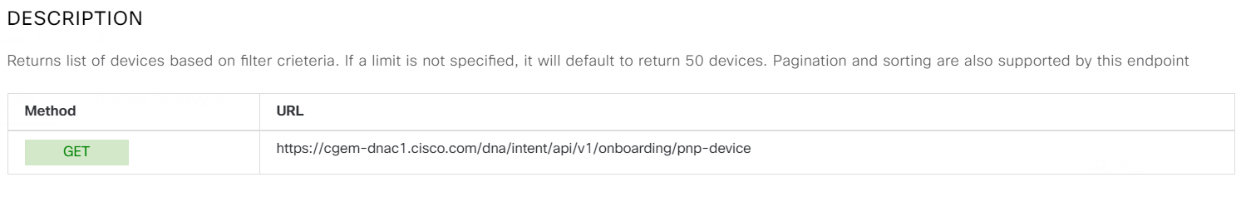
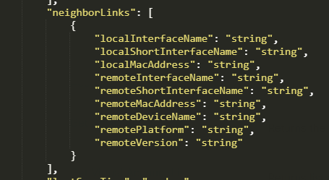
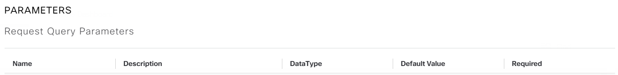
Get PnP Devices
dna/intent/api/v1/onboarding/pnp-device
Notes:
Closing could be probrlematic as it is first partner LED

Slide 11
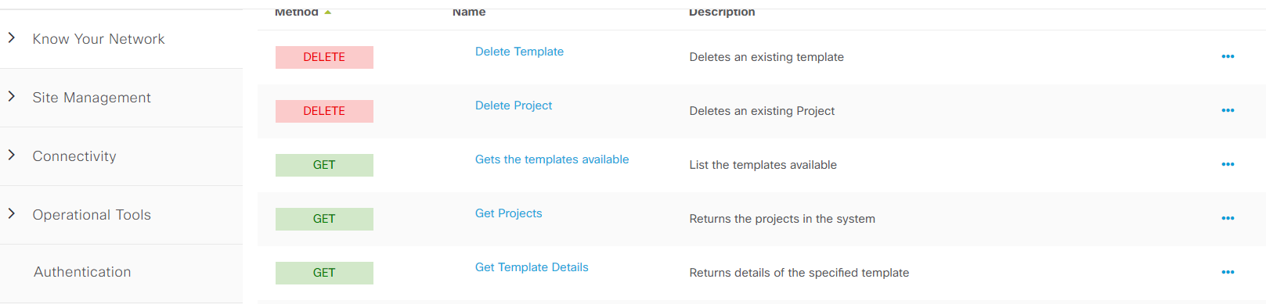
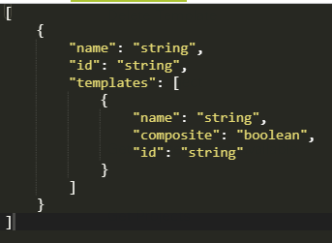
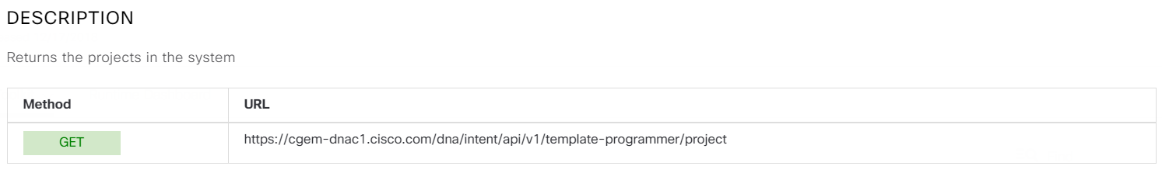
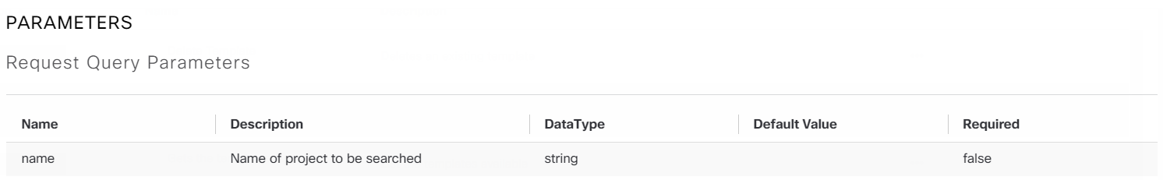
Get Templates
dna/intent/api/v1/template-programmer/project
Notes:
Closing could be probrlematic as it is first partner LED

Slide 12
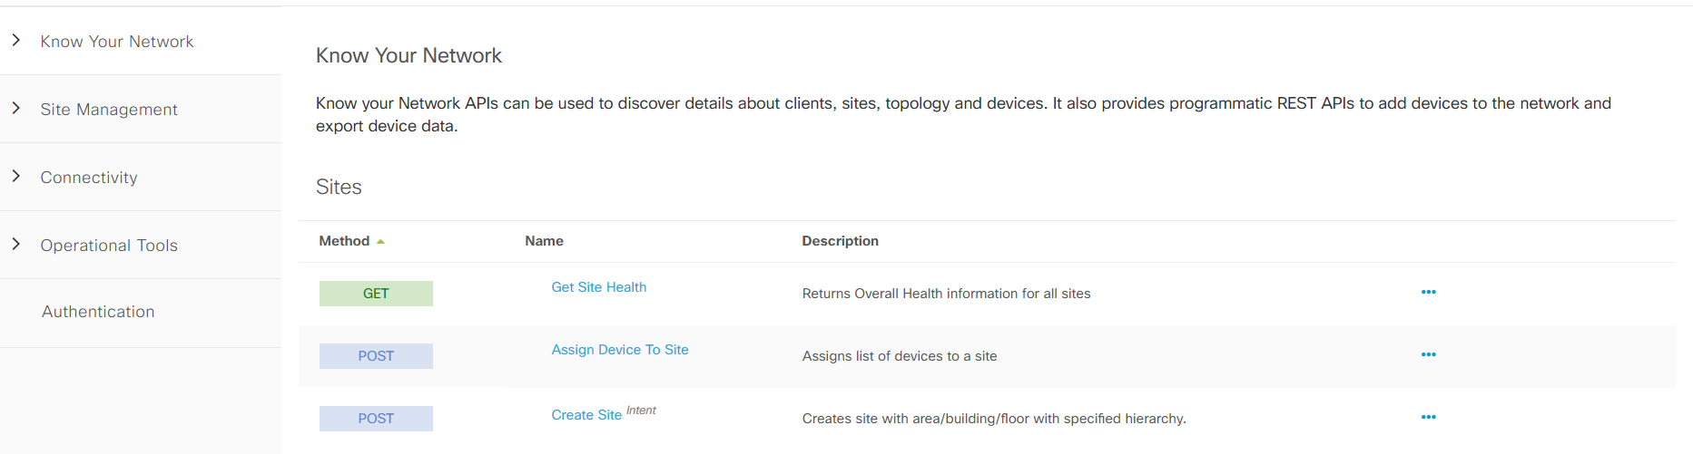
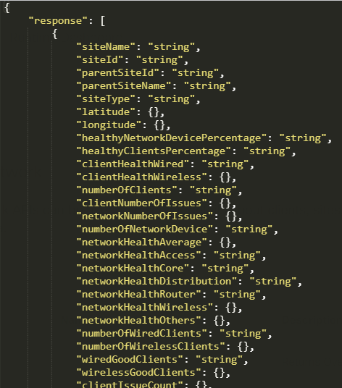
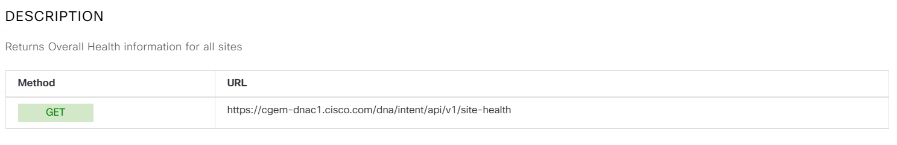
Get Site Id (from site Health API)
/dna/intent/api/v1/network-device/?role=…
Notes:
Closing could be probrlematic as it is first partner LED

Slide 13
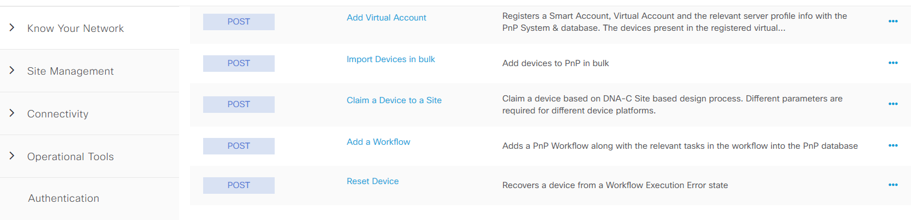
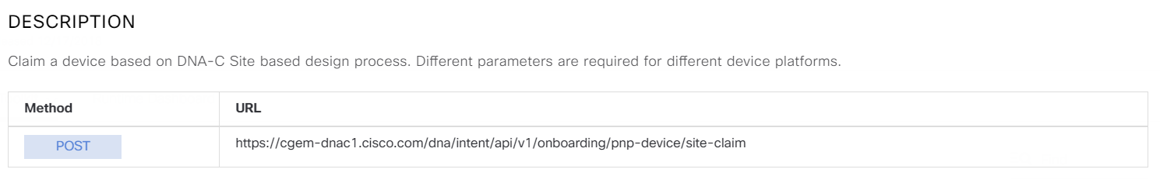
Case #4 – Claim Devices to Site
/dna/intent/api/v1/onboarding/pnp-device/site-claim
{"siteId":"",
"deviceId":"",
"type":"Default",
"imageInfo":
{
"imageId":"",
"skip":true
},
"configInfo":{
"configId":"",
"configParameters":[
{"key":"key1","value":"vlaue1"},
{"key":"key2","value":"vlaue2"}
]
}
}
Notes:
Closing could be probrlematic as it is first partner LED

